Slide 1



Eease ZOO
An easy administration for the wildlife.
Eease ZOO

Slide 2



Objective
The objective of the ZooEase application is to streamline zoo management by providing a platform for creating and managing zoo profiles and animal records. This tool aims to enhance efficiency, accuracy, and user-friendliness in zoo operations.
Eease ZOO

Slide 3

Business Rules
When adding a new animal to the zoo, the system will check the habitat assignment. This rule ensures that each species has an environment tailored to its specific needs, promoting better health and welfare for the animals.
A new zoo can only be created if the number of animals assigned to it does not exceed a predefined maximum limit. This limit is set to ensure that the zoo can provide adequate care and space for the animals. The limit may vary based on zoo type, location, or other specific criteria.
Eease ZOO

Slide 4
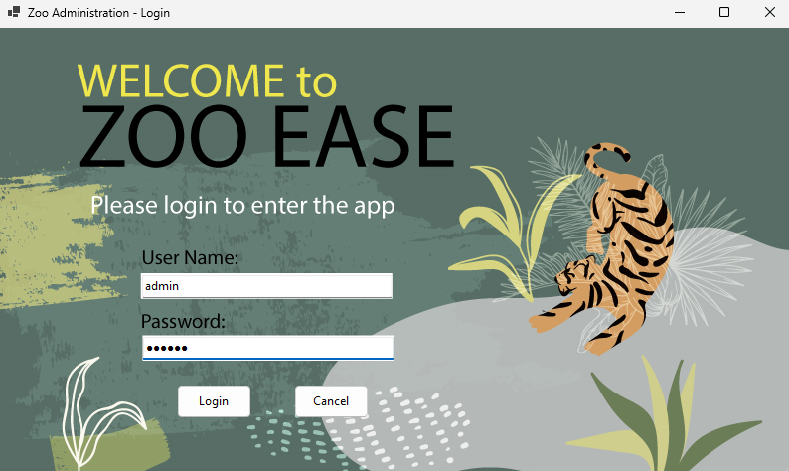
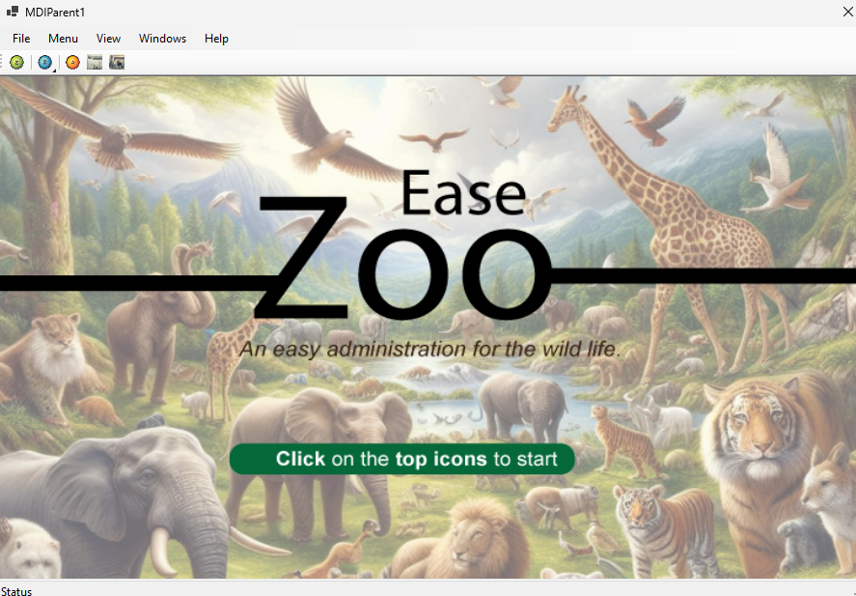
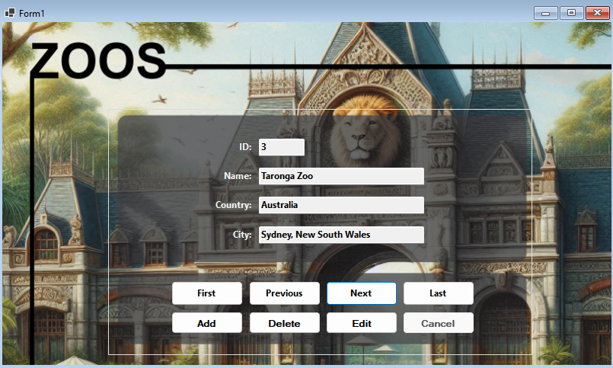
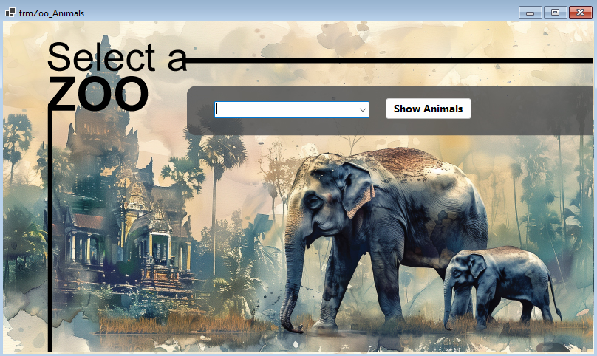
Eease ZOO

Slide 5
THANK YOU!

